Slide 1


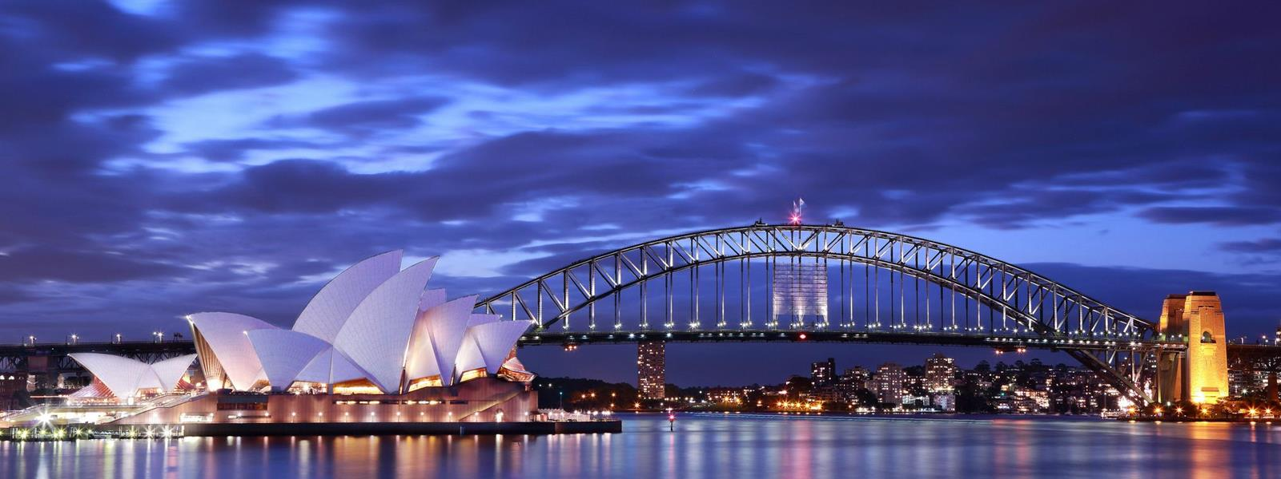

12
ENGLISH-SPEAKING COUNTRIES
Unit
LESSON 1: GETTING STARTED
A holiday in Australia

Slide 2
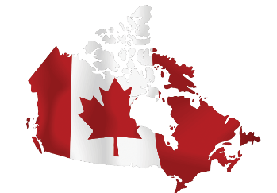
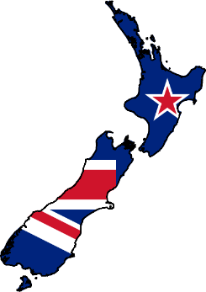
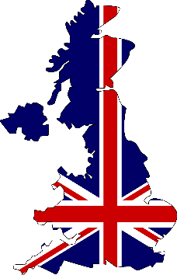

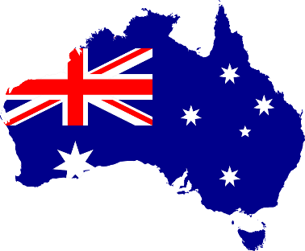
LESSON 1: GETTING STARTED
WARM-UP
Flags matching

Slide 3
WARM-UP
Flags matching
New Zealand
Canada
The USA
The UK
Australia

Slide 4
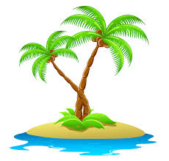

PRESENTATION
island (n)
/ˈaɪ.lənd/
Hòn đảo

Slide 5
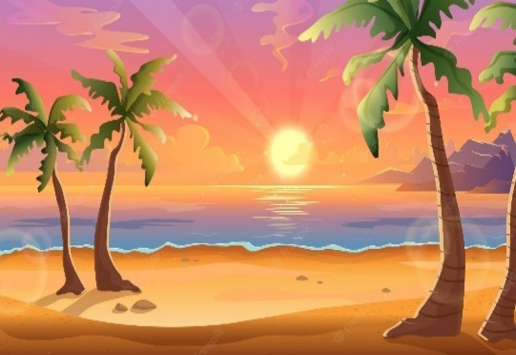
PRESENTATION
sunset (n)
/ˈsʌn.set/
Hoàng hôn

Slide 6

PRESENTATION
landscape (n)
/ˈlænd.skeɪp/
Phong cảnh

Slide 7
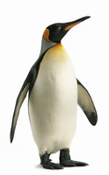
PRESENTATION
penguin (n)
/ˈpeŋ.ɡwɪn/
Chim cánh cụt

Slide 8
PRESENTATION
New words | Pronunciation | Meaning
island (n) | /ˈaɪ.lənd/ | Hòn đảo
sunset (n) | /ˈsʌn.set/ | Hoàng hôn
landscape (n) | /ˈlænd.skeɪp/ | Phong cảnh
penguin (n) | /ˈpeŋ.ɡwɪn/ | Chim cánh cụt

Slide 9
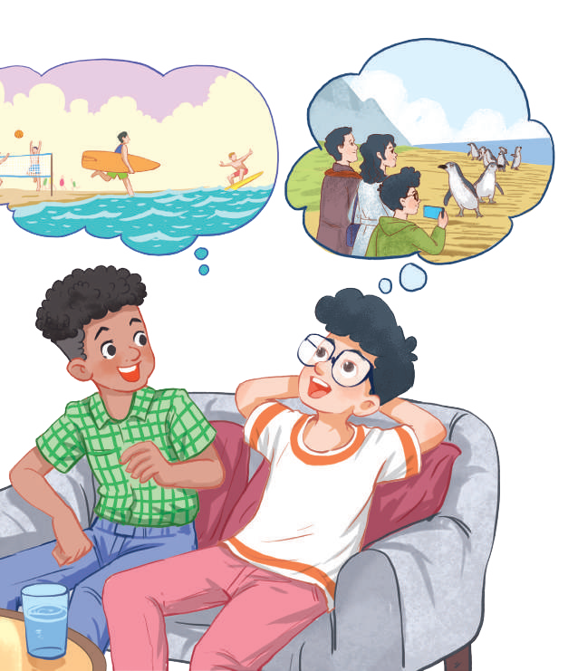
1. Listen and read.
Mark: How was your holiday in Australia, Phong?
Phong: It was fantastic! I got to use my English in real life: asking for directions, reading maps, talking to local people ...
Mark: Oh … Your English is much better.
Phong: Thanks.
Mark: Did you travel a lot?
Phong: Just around Melbourne, the city with four seasons in a day.
Mark: Wow ... I didn’t know that. How was it?
Phong: It was great! We took a tour to Phillip Island.
Mark: What did you see?
Phong: We went penguin watching.
Mark: It sounds pretty exciting.
Phong: It was. Australia has amazing landscapes.
Mark: Yes, and Australians love outdoor activities.
Phong: Right. There were plenty of people enjoying the parks and beaches.
Mark: I’m glad that you had a wonderful time there.
Phong: Thanks, Mark.

Slide 10
PRACTICE
2
What are Phong and Mark talking about?
A. Phong’s holiday in Australia
B. English-speaking countries
C. The tour to Phillip Island

Slide 11

PRACTICE
3
Read again and tick the information you can find in the conversation.
1. In Australia, Phong used English in real life.
2. Phong visited some museums.
3. Phillip Island is far from Melbourne.
4. Australia is beautiful.
5. Australians love outdoor activities.

Slide 12
PRACTICE
4
Complete the sentences with the words and phrases from the box.
island, sunset, landscape, Australians, penguin watching
1. This is a picture of the __________________ in my village.
2. – Where did you go _________________________?
– On the beach.
3. – Is Phu Quoc a(n) __________________?
– Yes, it is.
4. We had dinner on the beach after __________________.
5. Most ______________________ like outdoor sports and games.
landscape
penguin watching
island
sunset
Australians

Slide 13
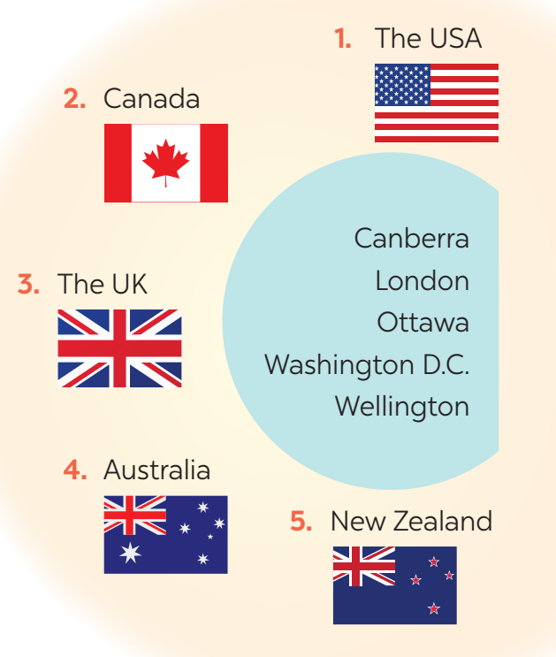
PRODUCTION
5
Matching game: What’s its capital city?
1. Washington D.C.
2. Ottawa
3. London
4. Canberra
5. Wellington

Slide 14
CONSOLIDATION
2
HOMEWORK
Find more English-speaking countries.

Slide 15


